Slide 1

Alex Wu
Alex Hansen

Slide 2
Why Pokémon?
Fans of Pokemon as we grew up
Wanted something challanging
Wanted a project rigerous in both the front and back end programming
Thought it would be fun

Slide 3
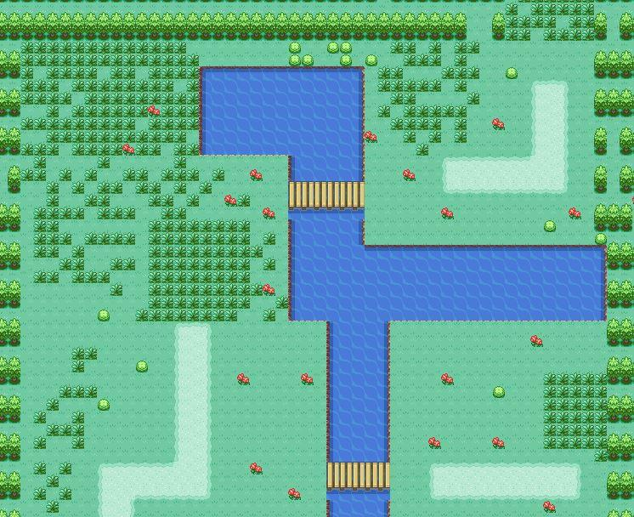
Basic Idea
Explore Map
Catch and Train Pokemon
Battle Trainers
151 Pokemon
Game easily expandable

Slide 4
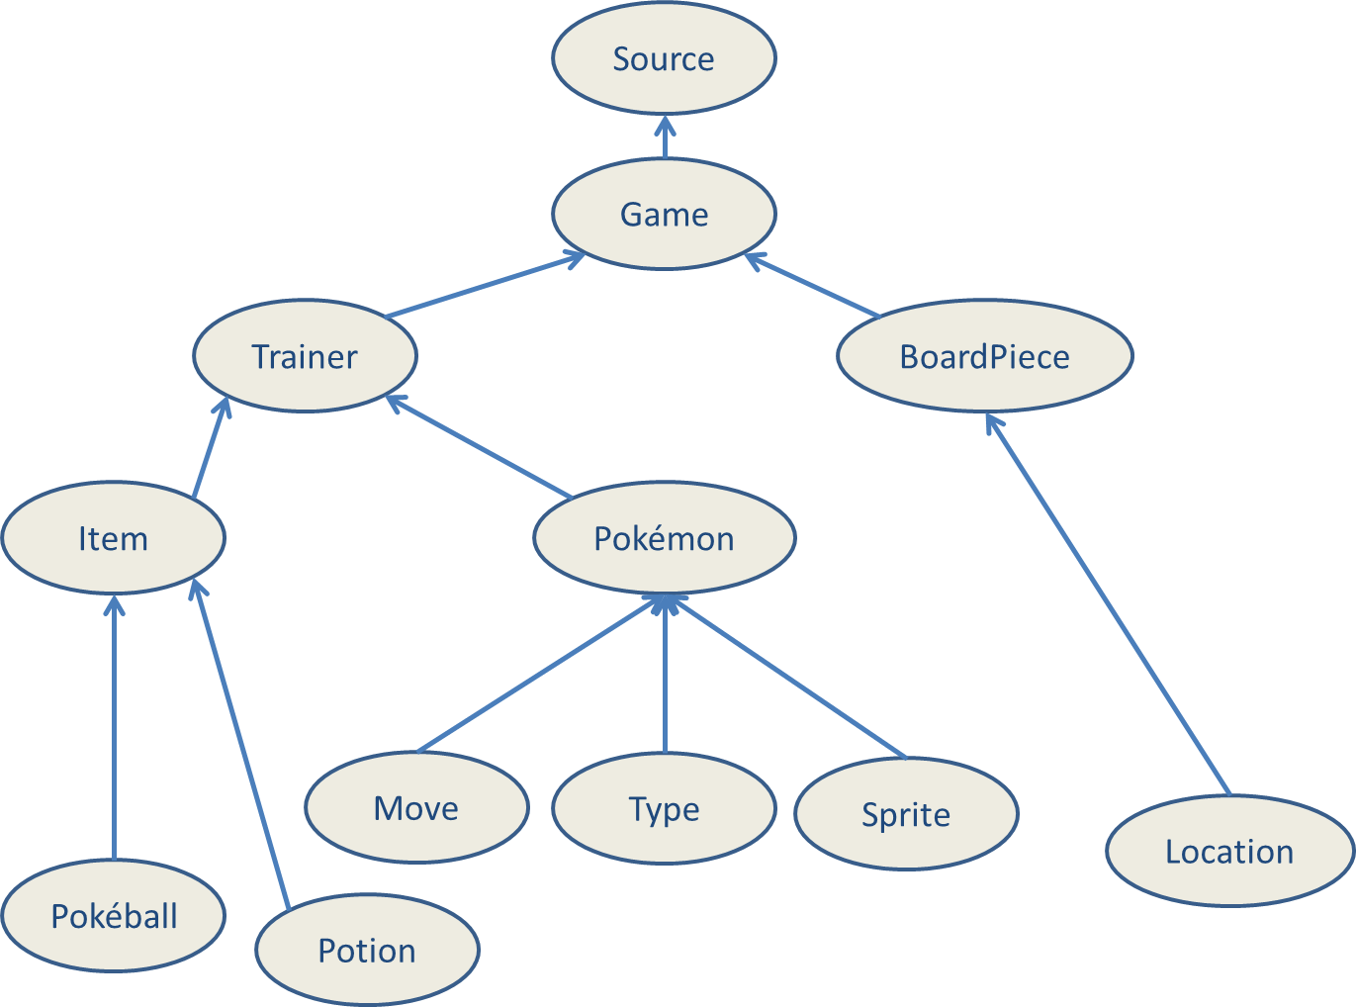
UML Diagram

Slide 5

OOP and Version Control
Composition
Inheritance
Github
OOP allowed multiple programmers to contribute simultaneously

Slide 6
Questions?

